Slide 1

Social Buzz Content Analysis
AWE SAMUEL
JULY 2024

Slide 2

Today’s agenda
Project Recap
Problem
Process
Insights
Summary

Slide 3

Project Recap
Social Buzz is a fast growing content tech company with vast amount of
data and wants to leverage that data to adapt on a global scale.
TASKS:
1. An audit of their big data practice
2. Recommendations for a successful IPO
3. An analysis of their content categories that highlight
the top 5 categories with the aggregate popularity.

Slide 4


Problem
Analysis to find Social Buzz’s top 5
Most popular categories of content

Slide 5
Process
Data Understanding 2. Data Cleaning
Data Modelling 4. Data Analysis
5. Insights 6. Recommendation

Slide 6

Insights
16
Distinct Categories
1897
Reactions to Animals
January
Month with the highest Post

Slide 7
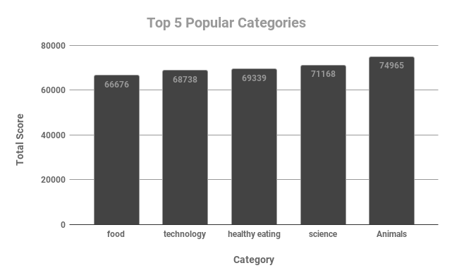
Insights

Slide 8
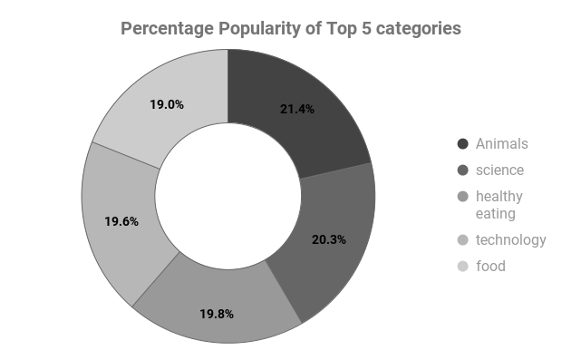
Insights

Slide 9

Summary
Categories: The two most popular categories are Animals and Science, meaning most of the user enjoys natural real life content and facts.
Recommendations:
- Food is one of the popular categories, and a collaboration with restaurants, food fests and healthy food organizations especially during months with the most engagements can potentially attract more users, and boost engagement
- Align with brands that create educational contents and events in the field of Science and Technology to potentially boost user engagement

Slide 10
Thank you!
ANY QUESTIONS?

